Slide 1

Medical Appointments 2016
Presented by: Omer Metwally
Last Updated: 10.^{th} January 2026

Slide 2
Table of Contents
Healthcare Operations
Objective
Data source
Data cleaning summary
The story with data.
Conclusion
Recommendations
Business Task

Slide 3
Objective

Slide 4

What are we talking about?
To analyze and visualize medical appointment data to identify key drivers of missed appointments, waiting time patterns, and patient behavior trends, helping healthcare providers reduce no-show rates, improve scheduling efficiency, and enhance overall patient experience.

Slide 5
Business Task

Slide 6

The healthcare provider aims to analyze patient appointment data to identify where and how no-show behavior and revenue leakage are concentrated across different clinic locations, patient demographics, and scheduling logistics.
The analysis focuses on answering key business questions to uncover:
Analyze Appointment Data across clinic locations, patient profiles, and scheduling timeframes.
1
Identify High-Risk Segments and underperforming clinics based on missed appointment volume and lost revenue.
2
Determine Logistical Priorities by ranking the impact of wait times and SMS communication gaps on attendance.
3
Examine Attendance Trends to detect weekly patterns, such as significant operational waste occurring on Fridays.
4
Provide Data-Driven Insights to support strategic scheduling, resource optimization, and financial recovery decisions.
5

Slide 7
Data source

Slide 8

Data set
The dataset used in this analysis comes from the Medical Appointment No Show — available on Kaggle
License: Open dataset provided for educational and analytical purposes.
The data has been used strictly for learning and non-commercial analysis.
Data License:
© Motivate International Inc. | Public data used for educational purposes only.

Slide 9
Data cleaning summary

Slide 10

Data cleaning
Removed duplicates
  Ensured each appointment record is unique to prevent double-counting of patient visits.
Handled missing values
  Checked for missing patient demographics, clinic locations, or appointment outcomes.
  Imputed or excluded records with missing critical fields to ensure statistical accuracy in influencer analysis.
Standardized formats
  Converted Scheduled Day and Appointment Day into standardized date formats for time-series analysis.
  Unified SMS received and Status (Show/No-Show) into consistent binary formats for metric calculation.
  Calculated and categorized Waiting Days into logical groups (Same Day, Short, Medium, Long).

Slide 11
Data cleaning
Validated data types
  Ensured numeric columns such as Age and Waiting Days are correctly typed for mathematical calculations.
  Checked that binary medical flags (e.g., Diabetes, Hypertension) are properly formatted as Boolean types.
Filtered irrelevant data
  Removed records with negative Waiting Days where scheduling dates occurred after the appointment date.
  Filtered out test records or appointments with incomplete clinical data to focus purely on valid patient behavior.
✅ Result:
Clean and structured dataset ready for identifying no-show drivers and creating the Operational Efficiency dashboard..

Slide 12
The story with Data

Slide 13
Identify The Highest Volume Of Missed Appointments.

Slide 14
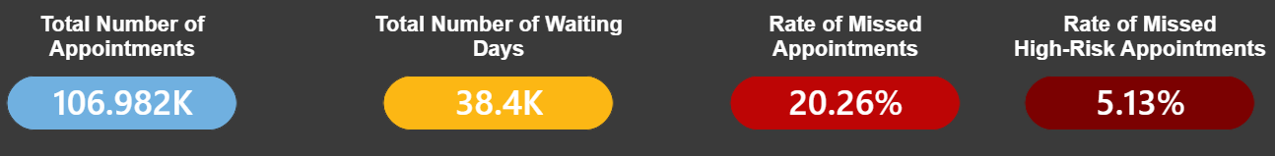
In May alone, 78K appointments were recorded—nearly three times more than April and June combined—with the majority not receiving SMS notifications.

Slide 15
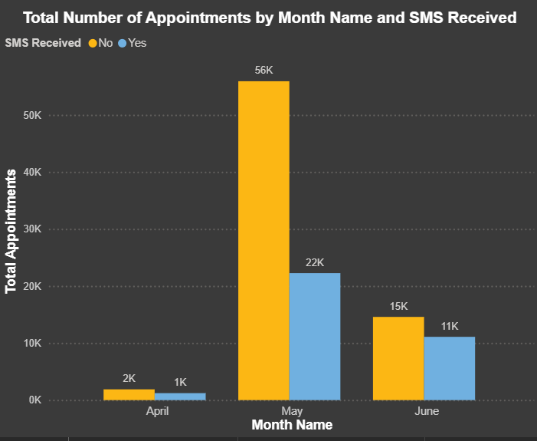
In May alone, 78K appointments were recorded—nearly three times more than April and June combined—with the majority not receiving SMS notifications.

Slide 16
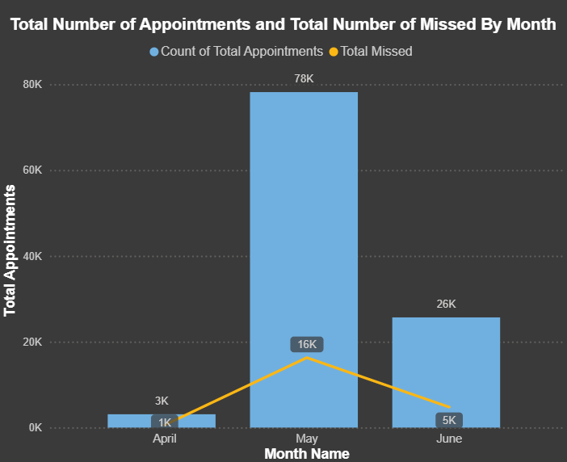
May saw a dramatic surge with 78K appointments and 16K missed, far outpacing April and June combined.

Slide 17
Identify Which Groups Are
Causing The Highest Volume Of Missed Appointments.

Slide 18
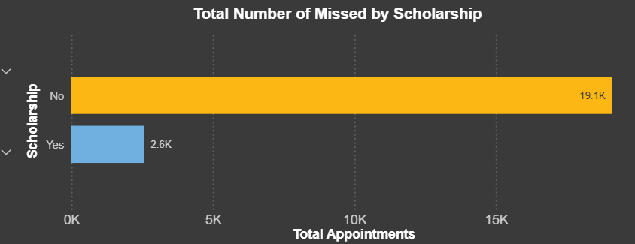
Individuals without scholarships missed 19.1K appointments—over seven times more than those with scholarships.

Slide 19
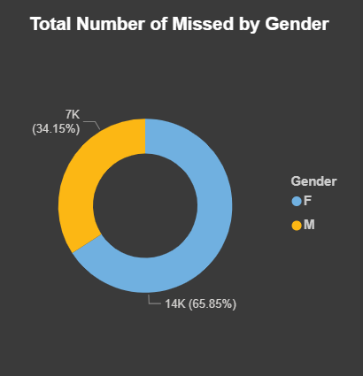
Females accounted for nearly two-thirds of missed appointments, totaling 14K compared to 7K for males.

Slide 20
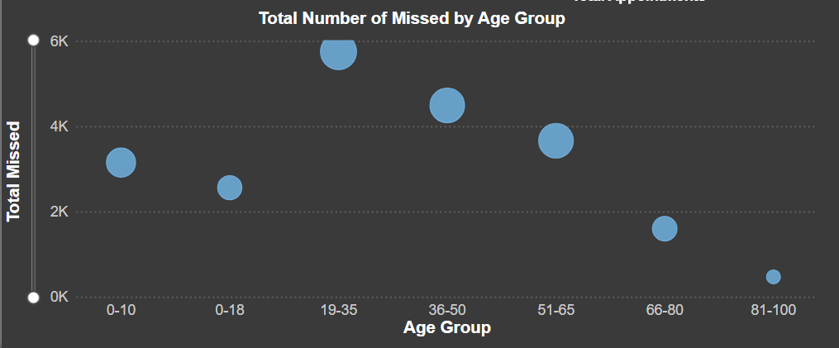
Adults aged 36–50 missed the most appointments, significantly outpacing all other age groups.

Slide 21
Identify Reasons That Are Causing The Highest Volume Of Missed Appointments.

Slide 22
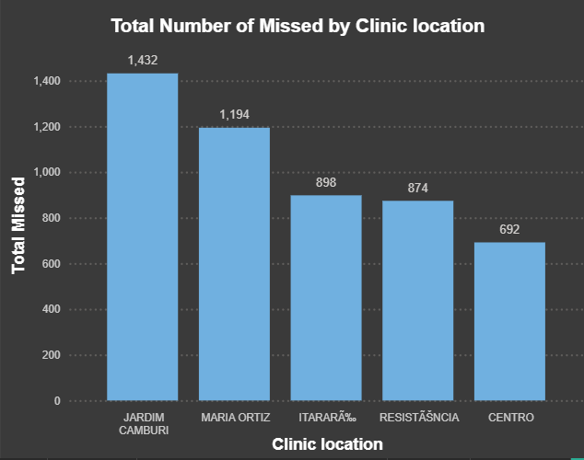
Jardim Camburi had the highest number of missed appointments (1,432), leading all five clinics in no-shows.

Slide 23
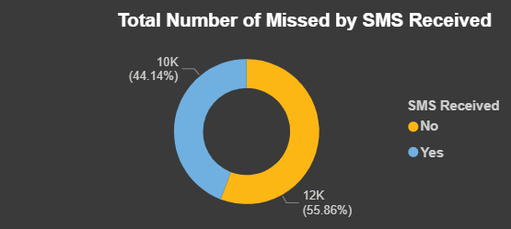
More missed appointments occurred when no SMS was received (12K), making up 55.86% of the total.

Slide 24
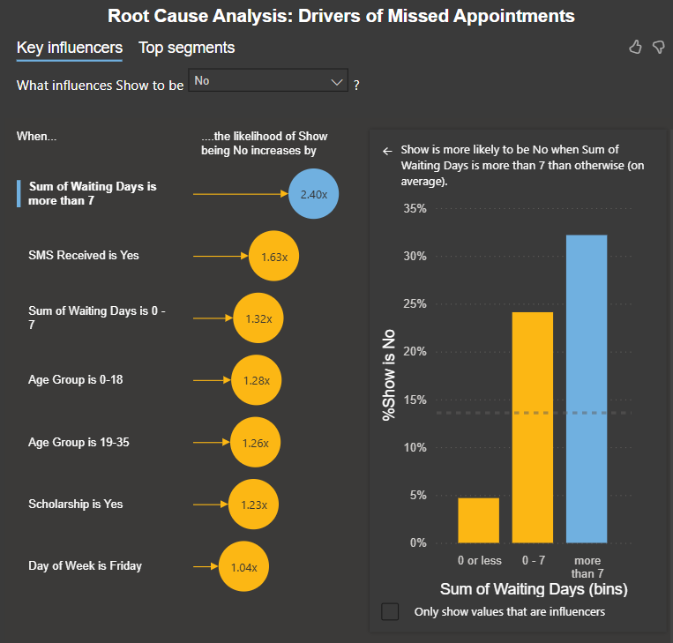
Long waiting times (over 7 days) are the strongest driver of missed appointments, increasing no-show likelihood by 2.4x.

Slide 25
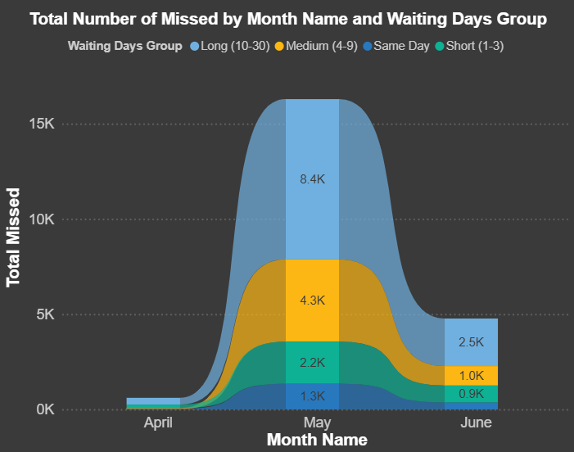
In May, missed appointments peaked at 16K, driven mostly by long waiting times of 10–30 days.

Slide 26
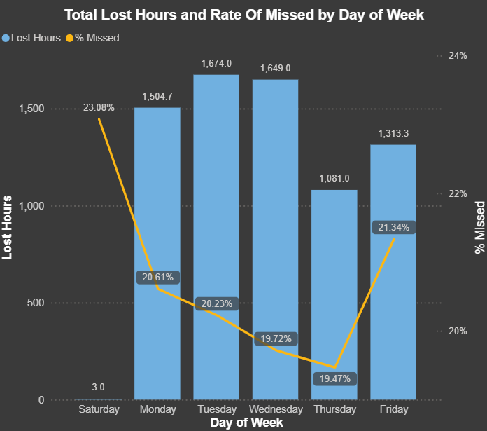
Tuesday had the highest lost hours (1,674), while Saturday showed the highest missed rate at 23.08% by missed (9) of total (39) appointments.

Slide 27
Appointments Efficiency & Resource Waste Analysis.

Slide 28
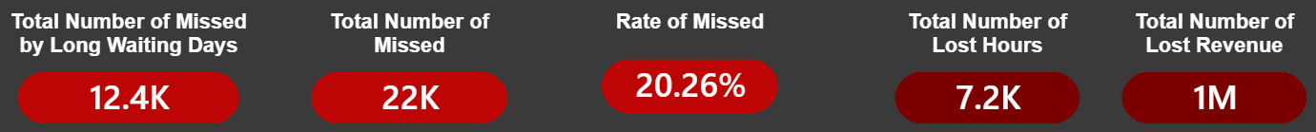
Long waiting times contributed to over half of the 22K missed appointments, driving 7.2K lost hours and $1M in lost revenue.

Slide 29
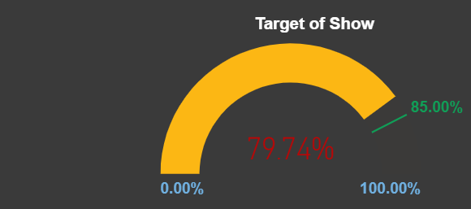
The current show rate stands at 79.74%, falling short of the 85% target.
We need 5.26% more to reach target rate of show

Slide 30
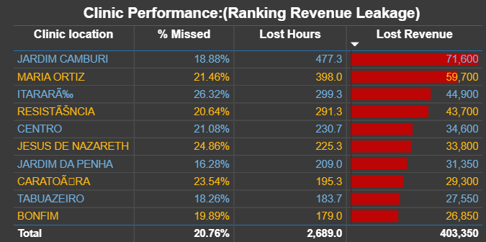
Jardim Camburi leads in revenue leakage with $71,600 lost, contributing to a total clinic loss of $403,350 from missed appointments averaging 20.76%.

Slide 31
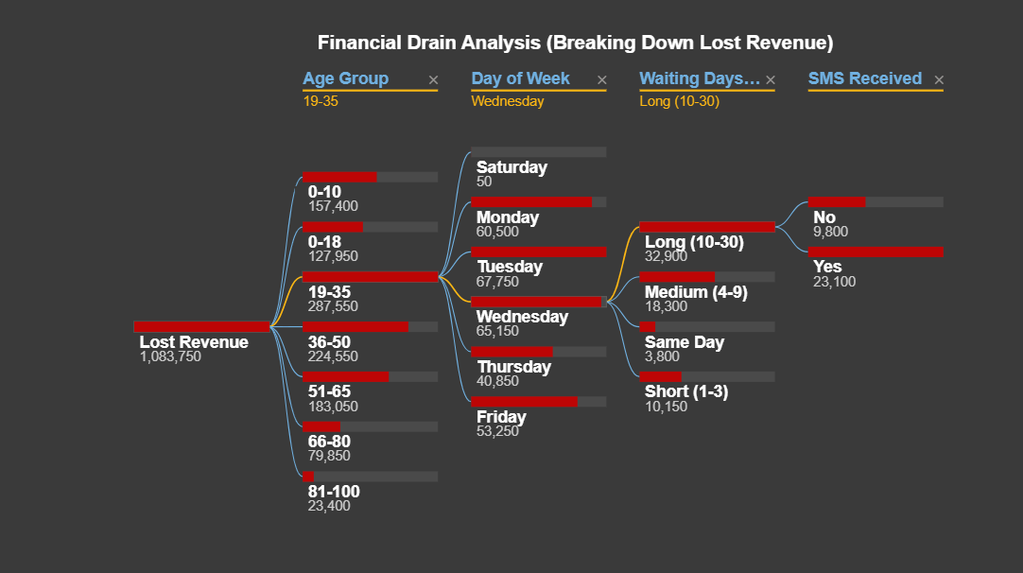
largest financial losses stem from patients aged 19–50, especially on Wednesdays, with long waiting times (10–30 days) and even among those who received SMS reminders.

Slide 32
Conclusion

Slide 33
Strategic Insights.
Gender distribution is similar for both groups, but overall usage is male-dominated.
Profit shows strong seasonality, with Q4 contributing nearly 40% of annual revenue.
The "7Day Risk": [High Priority] Patients waiting more than 7 days are 2.48x more
likely to miss their
appointment.
SMS Communication
Gap: [Quick Win]
Currently, 32.33% of
appointments are not
receiving SMS reminders
Friday Operational
Waste: [Strategic
Adjustment] Fridays
show the highest no- show rate at 21.34%
causing the most
significant "idle time“
for staff.
1
2
3

Slide 34
Strategic Insights.
Gender distribution is similar for both groups, but overall usage is male-dominated.
Profit shows strong seasonality, with Q4 contributing nearly 40% of annual revenue.
Geographic Focus: [Critical Local Action] The ITARARÃ clinic
alone accounts for
$44,900 in lost revenue with a 26.17% no-show rate.
Low-Risk "Reliable” Profiles: [Resource Optimization]
Patients with hypertension or diabetes show lower no-show rates (~ 17-18%)..
Scholar-Status Risk:
[Social Support Action]
Patients with
"Scholarship" status are 1.23x more likely to miss appointments.
4
5
6

Slide 35
Recommendations

Slide 36
Gender distribution is similar for both groups, but overall usage is male-dominated.
Profit shows strong seasonality, with Q4 contributing nearly 40% of annual revenue.
Recommendations Summary
Implement an
automated
"Confirmation Call“
for any appointment booked more than 1 week in advance.
Expand SMS
coverage to 100% of
patients; historical
data shows a
significant drop in
missed appointments when reminders are
received.
Consider a "Friday
Overbooking“strategy
(5-10%) or moving
staff meetings to Friday afternoons to maximize resource utility.
1
2
3

Slide 37
Gender distribution is similar for both groups, but overall usage is male-dominated.
Profit shows strong seasonality, with Q4 contributing nearly 40% of annual revenue.
Recommendations Summary
Launch a pilot "Direct Outreach" program
at this location to
identify local barriers (e.g., transportation
or access).
Prioritize these
patients for high-value specialist slots to ensure maximum
revenue stability.
Investigate if transportation vouchers or community health worker follow-ups can remove barriers for this specific socio-economic group.
4
5
6

Slide 38

Thank You!
Omer Metwally | Aspiring Data Analyst
Tools Used:
  Excel
  Power Bi
    Power Query
    DAX
    AI-Powered Visuals, Interactive Reporting Tools
Last Updated: 10.^{th} January 2026

